Slide 1
Campus Information Chatbot Using Streamlit
By Gopalakrishnan Kumar, MTech IIT-Bombay,
Freelance Data Science Consultant
LinkedIn: Profile Link : https://www.linkedin.com/in/gopalakrishnankumar-a73301110/
Github:https://www.github.com/Gopalakrishnan-Kumar/
Kaggle URL- https://www.kaggle.com/gopalkk2

Slide 2
Google Colab URL
https://colab.research.google.com/drive/1gp2W3WJf-tEfKDnTK4T5NbdU-PaWfz03?usp=sharing

Slide 3
Project Objectives
The goal of this project is to build a Campus Information Chatbot using Python and Streamlit. This chatbot assists students and visitors by answering common campus-related queries such as library hours, admissions, hostel details, and event schedules. It provides quick access to information in a user-friendly, conversational format.

Slide 4
Tools and Technologies Used
Python: Programming language used for development.
Streamlit: Lightweight web framework for building interactive apps.
Pandas: For data handling and manipulation.
Matplotlib: For plotting histograms and visualizations.
CSV Dataset: Used to store questions and answers.

Slide 5
Dataset Description
File Name: campus_faq.csv
Structure: Two columns – Question and Answer
Sample Entries:
What are the library hours? → The library is open from 8 AM to 10 PM on weekdays.
How to apply for a hostel room? → Apply online via the Student Portal.
This dataset can be easily extended with more question-answer pairs for broader coverage.

Slide 6
Chatbot Functionality
Accepts natural language queries from users.
Searches the dataset for a matching or partially matching question.
If a match is found, it displays the corresponding answer.
If no match is found, it suggests alternative support.

Slide 7
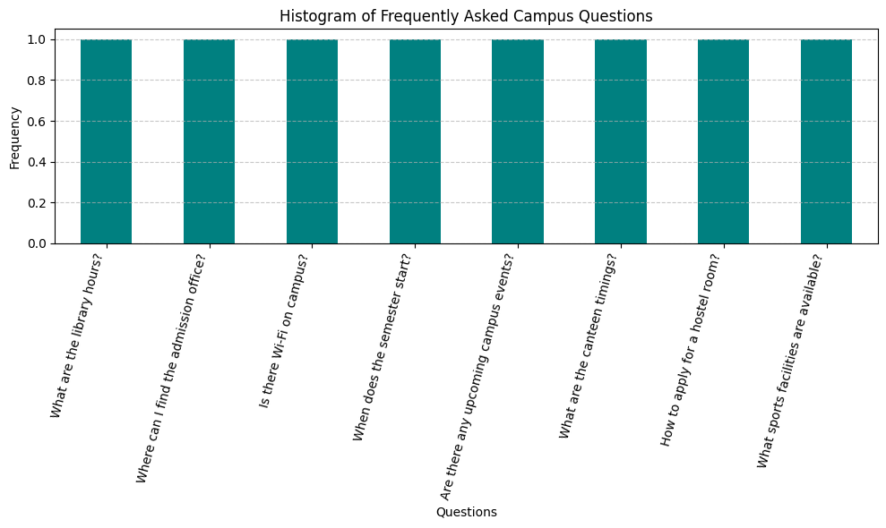
Data Visualization

Slide 8
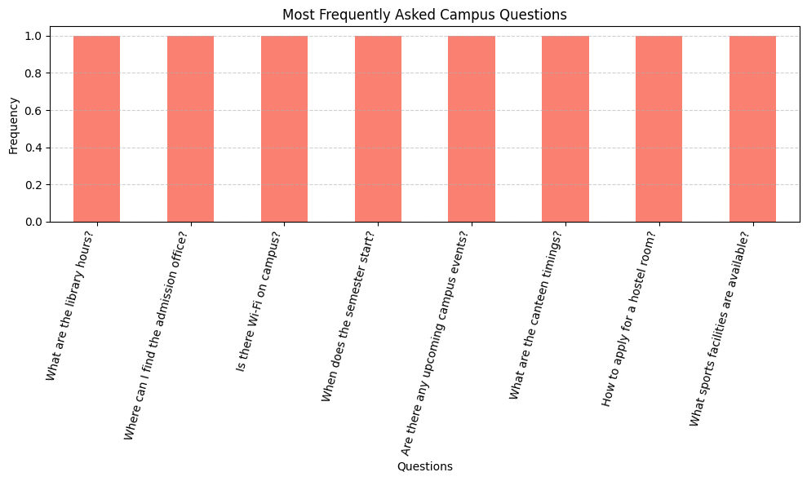
Data Visualization

Slide 9
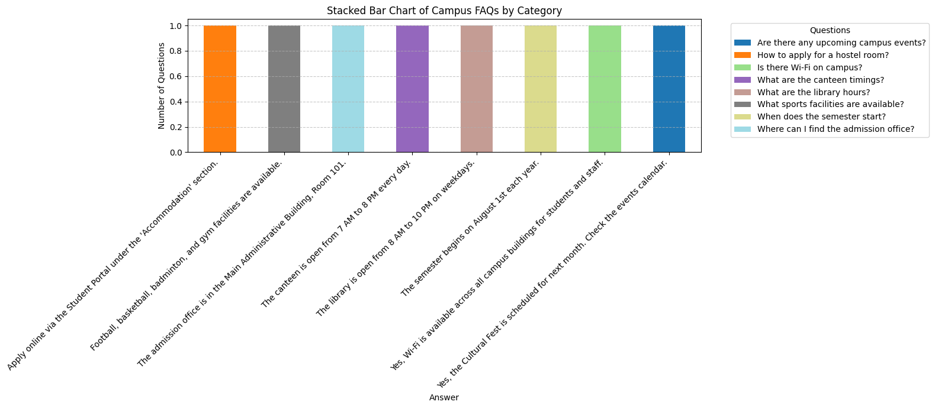
Data Visualization

Slide 10
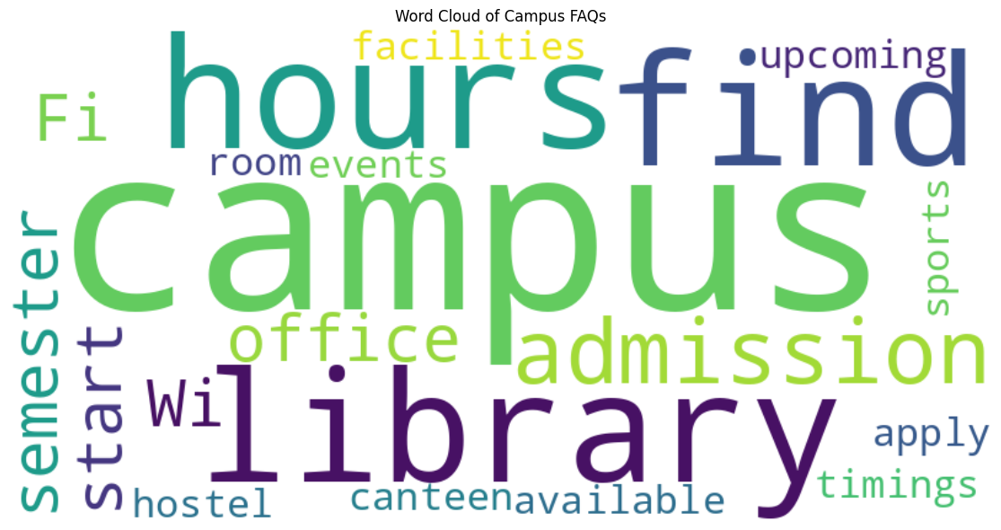
Data Visualization

Slide 11
How to Run
Unzip the campus_chatbot_package.zip
In terminal or command prompt, run:
bash
streamlit run campus_chatbot.py
The Chabot interface will appear in your browser.

Slide 12
Advantages
Fast, accessible help for students
Minimal development effort
Easy to update (just add new rows to the CSV)
Open-source and low-cost tech stack

Slide 13
Future Enhancements
🔍 Fuzzy Matching: Improve response matching for vague questions
💬 Chat Memory: Store user interaction history
🌐 Multilingual Support
🤖 LLM Integration: Integrate OpenAI or BERT for natural conversations
📈 Admin Dashboard: Track usage and query analytics

Slide 14
Conclusion
This Campus Chatbot demonstrates how simple tools like Streamlit and CSV datasets can be leveraged to build efficient and informative tools for educational institutions. It's scalable, easily customizable, and serves as a solid foundation for more advanced AI-based virtual assistants.

